Slide 1
Creating Opportunities for Young Adults

Slide 2
Context

Slide 3
Efficiency & effectiveness

Slide 4
Both efficiency and effectiveness are needed in the economy. The focus on efficiency sometimes precludes good business decisions about future effectiveness

Slide 5
Global economy

Slide 6
Youth unemployment 2012:
In some Arab countries, up to 90% of 16-24 year olds are unemployed.
In the United States the youth unemployment rate is 23%.
In Spain over 50%.

Slide 7
Davos 2012
The world, is sitting on a social and economic time bomb.
The world is plagued by youth unemployment.

Slide 8
In the UK the number of 16-24 year olds looking for work has topped one million.
Excluding those in full-time education, the figure is over 20%.
http://www.bbc.co.uk/news/10604117

Slide 9
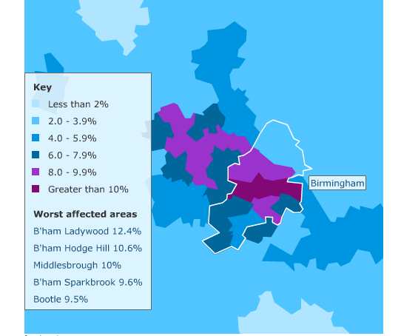
From http://www.bbc.co.uk/news/10604117

Slide 10
Local government service agreements and support to the voluntary sector have been cut.

Slide 11
Headlines
Graduates paying to work for free
One in 12 young people join UK's "jobless generation".
Begging for work

Slide 12
Headlines
Give a 'hoodie' a job - Employment Minister Grayling
Lost generation
Youth unemployment risks civil unrest

Slide 13
Headlines
UK unemployment: 'I applied for 1,639 jobs‘
Tragic suicide highlights plight of young unemployed
Notes:
There were significant associations between unemployment and suicide in both males and females. Associations were generally stronger at younger ages.
BJPsychiatry

Slide 14
Impacts

Slide 15
Charity workers say they're helping more young people because of high youth unemployment brought on by the economic crisis.

Slide 16
The Trussell Trust which runs the UK's only national network of food banks says it is seeing more 16 to 30-year-olds through its doors.

Slide 17
Food bank manager Mark Ward:
"People don't like to admit they need help. They will try every possible avenue before they come to us. The first time they come to us they will be very hungry as they.. have nothing in the house.”

Slide 18
Depression and Suicide
“There were significant associations between unemployment and suicide in both males and females. Associations were generally stronger at younger ages.”
Suicide and unemployment in young people.
Analysis of trends in England and Wales, 1921-1995.
Gunnell et al; British Journal of Psychiatry

Slide 19
Comments of young people
“They should at least give us a chance”
“When I started university the government said to students that a degree would set them up for life.
To go through the system and realise there are no jobs at the end of it is a bit like a kick in the teeth.”

Slide 20
“I’ve been unemployed since last April [2010]. Because it’s been a long time my confidence has got low. I’ve been trying to get work trials where you go to an organisation and offer to work for them for free for two weeks. But they just don’t want to know.

Slide 21
They treated me like it was a hassle to them. I think it was a lot to do with stereotyping. If you’re young and you’ve been out of work for a long time, you must be lazy. But not everyone out there just sits on their backside. There are people who really try hard to get work.“

Slide 22
For young people, long-term unemployment means.
lower earnings,
more unemployment,
more ill health later in life.
ACEVO Commission on Youth Unemployment

Slide 23
more inequality between rich and poor
particular challenges for young women
more division between communities.
ACEVO Commission on Youth Unemployment

Slide 24
“This is a crisis we cannot afford.”
ACEVO Commission on Youth Unemployment
The [financial] costs of current levels of long-term youth unemployment – now and in the future – are enormous.

Slide 25
Youth unemployment at its current rates (for 2012):
Will cost the exchequer £4.8 billion
Will cost the economy £10.7 billion in lost output
ACEVO Commission on Youth Unemployment

Slide 26
Estimated long term costs:
£2.9 billion p.a.for the exchequer (= annual Jobcentre Plus budget )
£6.3 billion p.a. for the economy in lost output.
ACEVO Commission on Youth Unemployment

Slide 27
Responses

Slide 28
Behind the headlines there are two challenges.
First, we are in the midst of a crisis driven by low levels of demand for young people’s labour
Second, Britain has a structural youth unemployment problem
ACEVO Commission on Youth Unemployment

Slide 29
“Fractured responsibility”
ACEVO Commission on Youth Unemployment

Slide 30
Employers
For example, Employers might take more responsibility for long term training needs and development of employees

Slide 31
Government
For example, Government might take more responsibility for resourcing education which relates to real job needs in the economy

Slide 32
Inter-generational
For example, dependence on young people to create wealth to pay off debts older people accrued might be balanced with more inclusion of young people in the wealth created by that debt based economy.

Slide 33
Pay rates
For example, senior executives might not to accept pay rates unrelated to a company’s performance.

Slide 34
Taking responsibility

Slide 35
I AM ONE IN A MILLION:
YOUNG PEOPLE’S EXPERIENCES OF UNEMPLOYMENT
Church Urban Fund and Frontier Youth Trust

Slide 36
Practical responses

Slide 37
The church can be involved in
Events
Resourcing
Funding
Partnering
New Projects

Slide 38
EXAMPLES
Worth Unlimited (eg Gear Up)
The Jericho Foundation

Slide 39
EXAMPLES
‘Christians Against Poverty’ and ‘Credit Action’
YMCA

Slide 40
EXAMPLES
Links with FE colleges.
Information easily available in church buildings.

Slide 41
EXAMPLES
Volunteering
Buildings supporting fledgling businesses with office space etc.

Slide 42
EXAMPLES
Only using companies with apprentices
New ways of working (shorter week)

Slide 43
EXAMPLES
Job centre chaplaincy
Job clubs

Slide 44
EXAMPLE

Slide 45
Why form a company?
The principle aim behind the formation of this company is to benefit large numbers of young people who need jobs.
This is a company which creates work and adds value to communities.

Slide 46
labour intensive
effective
profitable

Slide 47
The company will
employ green technology
improve local properties
improve community spaces
focus on areas of multiple deprivation

Slide 48
be self sustaining
invest in and improve existing community assets
widen access to affordable housing
focus on developing skills

Slide 49
Structure
Initial Directors
Executive Directors
Employees

Slide 50
Who?

Slide 51
How & When?
Funding
Identification of properties
CIC Asset Lock

Slide 52
Where?
Areas of multiple deprivation
in the West Midlands

Slide 53
Integrated
Responsibility
- a hopeful way forward

Slide 54
Comments welcome!
stephen.willey@necgroup.co.uk

